Slide 1
Current Issues: Export of New Vehicles
Sarah M. Bernstein, Esq.
Barack Ferrazzano Kirschbaum & Nagelberg LLP
Monica Baumann, Esq.
California New Car Dealers Association
NAMBVC Fall Workshop
September 15, 2016

Slide 2
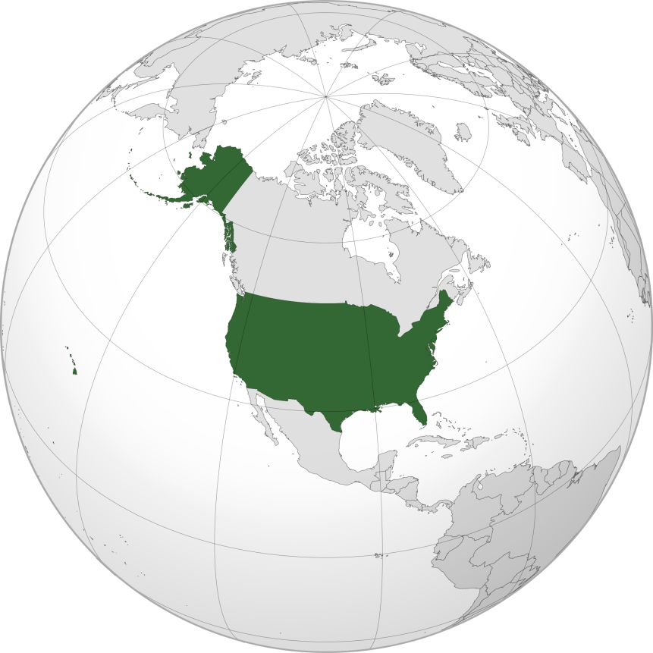
Sell, Sell, Sell (Just Not Outside of the U.S.)

Slide 3
What is an Export?
A U.S. dealer sells a new motor vehicle in the U.S. that is subsequently transported outside of the U.S. and resold as new, or registered as new, in another country

Slide 4
How do Exports Happen?
A U.S. dealer sells a new motor vehicle to:
An export company that resells the vehicle to a customer outside of the U.S.
A broker that resells the vehicle to a customer outside of the U.S.
An individual customer who transports the vehicle for registration by a third party outside of the U.S.
An individual customer who transports the vehicle for registration for his or her own use outside of the U.S.

Slide 5
Why do Exports Concern Manufacturers (and Dealers)?
They impact compliance by manufacturers with regulatory requirements, including safety requirements
They impact warranty and recall matters
They impact the customer experience
They impact sales and service opportunities outside the U.S. and in the U.S.
When a vehicle leaves the country so do many opportunities

Slide 6
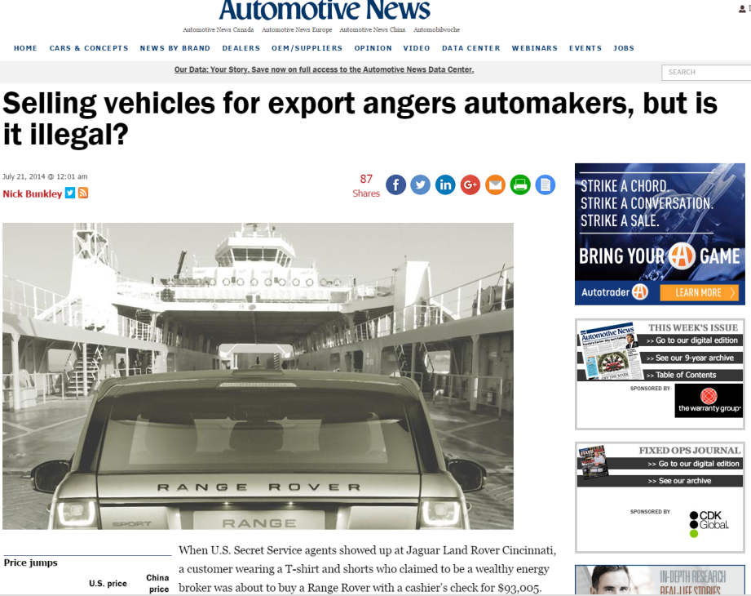

Slide 7
How do Manufacturers Address Exports?
To address exports, manufacturers adopt policies that:
Prohibit a dealer from selling new vehicles to any person or entity that the dealer knows or should know intends to directly or indirectly export the vehicle outside of the U.S.
Require a dealer to engage in due diligence to confirm that the customer to whom it is selling a vehicle does not intend to export the vehicle
Prohibit a dealer from selling new vehicles to person any or entity on “Known Exporters List”

Slide 8
How do Manufacturers Enforce Policies?
Policies provide manufacturers with the right to audit dealer’s sales records
New vehicle exported outside of the U.S. may not count for dealer’s sales rate for determining allocation
Manufacturer may charge back any incentives earned by dealer on sale

Slide 9
Why is there a Need for Enforcement?
Manufacturer is not getting its end of the incentives bargain
Not getting a U.S. customer relationship
Not getting repeat contact with U.S. customer
Not getting downstream benefits of U.S. customer (next sale, CPO sales, parts sales)
Not getting dealer focus on local customer relationships and local customer experience

Slide 10
Why is there a Need for Enforcement?
(Continued)
Manufacturer is allocating vehicles for U.S. distribution
Dealer network and manufacturer better served by keeping vehicle in the U.S. (downstream profit opportunities)
Want U.S. customer to enjoy use of vehicle
Want vehicle to be seen on U.S. roadways (intangible benefit to brand image with more vehicles on U.S. roadways)

Slide 11
Why is there a Need for Enforcement?
(Continued)
When consumers lose, the manufacturer and its dealers lose
If tight supply, may have to wait longer to get desired vehicle
Dealer that is less focused on local consumers is less responsive to local customers

Slide 12
Dealer Concerns with Exporting
Due diligence requirements
Often onerous, multi-faceted
Dealers fear accusations of discrimination
Enforcement can be steep
Exporter motivation is extremely high
Some manufacturers have adopted a strict liability approach

Slide 13
Exporting is Lucrative
Luxury cars can bring up to three times their original U.S. price when exported to China.
Car U.S. price China price
Mercedes-Benz GL63 $118,560 $319,190
Range Rover $84,225 $241,480
BMW X6 xDrive35i $61,900 $171,326
Porsche Cayenne $49,600 $148,594
Audi Q7 $47,700 $133,326
Tesla Model S 85 $81,070 $121,370
Source: Automotive News

Slide 14
“[I]t appears to the Court that the primary concern of the manufacturers is guarding their foreign market profits from competition." Source: Autoweek, “Exporting New Luxury Cars is Lucrative, Legally Questionable” July 22, 2014

Slide 15
Franchise Laws Address Dealer Concerns
Vehicle Code Section 11713.3 It is unlawful and a violation of this code for a manufacturer, manufacturer branch, distributor, or distributor branch licensed pursuant to this code to do, directly or indirectly through an affiliate, any of the following:
(y)(1) To take or threaten to take any adverse action against a dealer pursuant to an export or sale-for-resale prohibition because the dealer sold or leased a vehicle to a customer who either exported the vehicle to a foreign country or resold the vehicle in violation of the prohibition, unless the export or sale-for-resale prohibition policy was provided to the dealer in writing at least 48 hours before the sale or lease of the vehicle, and the dealer knew or reasonably should have known of the customer’s intent to export or resell the vehicle in violation of the prohibition. If the dealer causes the vehicle to be registered in this or any other state, and collects or causes to be collected any applicable sales or use tax due to this state, a rebuttable presumption is established that the dealer did not have reason to know of the customer’s intent to export or resell the vehicle. In a proceeding in which a challenge to an adverse action is at issue, the manufacturer, manufacturer branch, distributor, or distributor branch shall have the burden of proof by a preponderance of the evidence to show that the vehicle was exported or resold in violation of an export or sale-for-resale prohibition policy, that the prohibition policy was provided to the dealer in writing at least 48 hours prior to the sale or lease, and that the dealer knew or reasonably should have known of the customer’s intent to export the vehicle to a foreign country at the time of the sale or lease.

Slide 16
New Additions to California Export Laws
Vehicle Code Section 11713.3 subsection (y)
(2) An export or sale-for-resale prohibition policy shall not include a provision that expressly or implicitly requires a dealer to make further inquiries into a customer’s intent, identity, or financial ability to purchase or lease a vehicle based on any of the customer’s characteristics listed or defined in Section 51 of the Civil Code. A policy that is in violation of this paragraph is void and unenforceable
Civil Code Section 51 characteristics: “sex, race, color, religion, ancestry, national origin, disability, medical condition, genetic information, marital status, sexual orientation, citizenship, primary language, or immigration status”

Slide 17
New Additions to California Export Laws
Vehicle Code Section 11713.3 subsection (y)
(3) An export or sale-for-resale prohibition policy shall expressly include a provision stating the dealer’s rebuttable presumption if the dealer causes the vehicle to be registered in this or any other state and collects or causes to be collected any applicable sales or use tax. A policy that is in violation of this paragraph is void and unenforceable.
Also allowed for association standing before the New Motor Vehicle Board.

Slide 18
Point/Counterpoint
Should exports of new vehicles be illegal?
Are statutory protections for dealers appropriate?
If so, what should those statutory protections include?
What level of responsibility should dealers have for policing sales outside of the U.S.?
What level of responsibility should manufacturers have for policing sales outside of the U.S?

